Slide 1
Lesson 13:
App UI design

Slide 2
About this lesson
Lesson 13: App UI design
Android styling
Typography
Material Design
Material Components
Localization
Example apps
Summary

Slide 3
Android styling
Notes:
To build a polished user experience in Android, you’ll first need to understand the building blocks of Android’s styling system. Understanding this will help you separate the details of your app design from the UI structure and behavior.

Slide 4
Android styling system
Used to specify the visual design of your app
Helps you maintain a consistent look across your app
Hierarchical (you can inherit from parent styles and override specific attributes)
Notes:
Android provides a rich styling system that lets you control the appearance of all the views in your app. You can use themes, styles, and view attributes to affect styling.
Using a combination of these will help you achieve a consistent look across your app.
The styling system is hierarchical. You can inherit from parent styles and override only the attributes you want.

Slide 5
Precedence of each method of styling
View
attributes
Overrides this
Style
Overrides this
Theme
Notes:
Transition: 1 click
The diagram shown here summarizes the precedence of each method of styling. The pyramid shows the order in which styling methods are applied by the system, from the bottom up. For example, if you set a text size of 18sp in the theme, set a text size of 16sp in a TextView style (that’s applied to the view), and then set the text size to be 14sp directly in the TextView attributes, the view attributes will take precedence over what was defined in the style or theme. What ends up being displayed to the user in the TextView is text at 14sp.
To summarize, view attributes always overwrite anything specified in a style or theme. And styles always overwrite anything specified in a theme.

Slide 6
Themes
Collection of named resources, useful broadly across the app
Named resources are known as theme attributes
Examples:
Use a theme to define primary & secondary colors in the app
Use a theme to set the default font for all text within an activity
Notes:
Let’s learn more about what a theme is.
A theme is a collection of named resources (known as theme attributes) that can be referenced more broadly across the app. The theme specifies concrete values for these theme attributes. You can reference these theme attributes in layouts, styles, etc..

Slide 7
Declare a theme
In res/values/themes.xml:
<style name="Theme.MyApp" parent="Theme.MaterialComponents.Light">
<item name="colorPrimary">@color/orange_500</item>
<item name="colorPrimaryVariant">@color/orange_700</item>
<item name="colorSecondary">@color/pink_200</item>
<item name="colorSecondaryVariant">@color/pink_700</item>
...
</style>
Notes:
Define a theme in your app’s res/values/themes.xml file. Use the <style> tag.
In this example, the theme is called Theme.MyApp. The primary color of this theme is determined by the colorPrimary attribute, which we set to a shade of orange. Setting this color affects your app broadly - a number of UI widgets (such as Button) rely on the primary color of the theme. Use theme attributes when defining your styles and layouts, so that these resource files can still be used under a different theme that provides different concrete resources.
When declaring a theme, you don’t have to specify a value for all the possible theme attributes. If you specify a parent theme, you inherit all the attribute values from it, and then you can just override the ones that you want to be different. In this example, we use Theme.MaterialComponents.Light as a parent theme, and then only provide resources for colorPrimary, colorPrimaryVariant, colorSecondary, and colorSecondaryVariant. To see a list of common theme attributes, check out the link in the resources below.
Resources:
Android Styling: Themes vs Styles
Android Styling: Common Theme Attributes

Slide 8
Apply a theme
In AndroidManifest.xml:
<manifest ... >
<application ... >
<activity android:theme="@style/Theme.MyApp" ... >
</activity>
</application>
</manifest>
In layout file:
<ConstraintLayout …
android:theme="@style/Theme.MyApp">
Notes:
Transition: 1 click
You can specify a theme on components that have (or are) a Context e.g. Activity or Views/ViewGroups.
When you create a project from a template in Android Studio, there’s already a custom theme for your app defined in the themes.xml file. That theme is already applied to the application or activity in the manifest file, so you probably don’t need to do this step manually. You will see this as the android:theme attribute on either the <application> tag or <activity> tag in the AndroidManifest.xml file.
Alternatively, you can apply the theme to a View/ViewGroup, such as the ConstraintLayout in this example.
In terms of scope, setting a theme on a ViewGroup applies to all the child views within it. Similarly, setting a theme on an Activity applies to the ViewGroups and Views within its hierarchy.

Slide 9
Refer to theme attribute in a layout
In layout file:
<LinearLayout …
android:background="?attr/colorSurface">
Use ?attr/themeAttributeName syntax.
Examples: ?attr/colorPrimary ?attr/colorPrimaryVariant
Notes:
You can define more flexible layouts and styles by referring to theme attributes instead of specific resources directly. To refer to a theme attribute, use the syntax ?attr/<theme attribute name>.
For this LinearLayout, instead of setting the background to a specific color, refer to the colorSurface theme attribute. This checks the theme for the value of the colorSurface attribute. (By the way, colorSurface refers to the color used for surfaces like cards, sheets, and menus.) This allows us to define the layout once, but the LinearLayout can have a different background color depending on which theme it’s used under.

Slide 10
Styles
A style is a collection of view attributes, specific to a type of view
Use a style to create a collection of reusable styling information, such as font size or colors
Good for declaring small sets of common designs used throughout your app
Notes:
You’ve learned that the scope of a theme can be applied to a broad set of View and ViewGroups. For defining the visual style across a more narrow scope of views, you may want to use a style instead.
A style is a collection of view attributes that are specific to a type of view. For example, a style for a TextView can specify attributes such as font color, font size, font family, and much more.
This is useful because if you have several views with a similar visual appearance, you can extract the common attributes into a style. By defining the style in one place, it simplifies the rest of the layout XML, improves app consistency, and simplifies visual updates and maintenance. For example, you can use a style to make consistently styled headers or a set of buttons.

Slide 11
Declare a style
In res/values/styles.xml:
<style name="DescriptionStyle">
<item name="android:textColor">#00FF00</item>
<item name="android:textSize">16sp</item>
...
</style>
Notes:
To create a new style, open your project's res/values/styles.xml file. For each style you create, follow these steps:
1. Add a <style> element with a name that uniquely identifies the style. In this case, we’ll call it DescriptionStyle.
2. Add an <item> element for each style attribute you want to define.
The name in each item specifies an attribute you would otherwise use as an XML attribute in your layout (such as android:textColor). The value in the <item> element is the value for that attribute.
Any TextView with DescriptionStyle will have these textColor and textSize attributes set on the view.
Note: even though a style and theme are both defined with the <style> syntax, they have different purposes. You can check out the blogpost for more on the difference between styles and themes.
Resources:
Android Styling: Themes vs Styles
Styles and Themes

Slide 12
Apply a style
On a view in a layout file:
<TextView
style="@style/DescriptionStyle"
android:layout_width="wrap_content"
android:layout_height="wrap_content"
android:text="@string/description_text" />
Notes:
Within a layout file, apply the style to a view by specifying its style attribute. The value will be the style resource you just created: @style/<name of style>.
In terms of scope, the style only applies to that view (not any of its children views).

Slide 13
Refer to theme attribute in a style
In res/values/styles.xml:
<style name="DescriptionStyle">
<item name="android:textColor">?attr/colorOnSurface</item>
<item name="android:textSize">16sp</item>
...
</style>
Notes:
Tying this back to what we learned earlier, you could also refer to a theme attribute within a style. For example, when we declare DescriptionStyle, the text color could refer to the theme attribute ?attr/colorOnSurface (instead of a specific hex value).

Slide 14
View attributes
Use view attributes to set attributes explicitly for each view
You can use every property that can be set via styles or themes
Use for custom or one-off designs such as margins, paddings, or constraints
Notes:
For styling that is specific to a single view, set the attributes specifically on the view. This will override any styling that gets inherited from the style or theme.
As you’re starting to see, the Android styling system offers a lot of flexibility. Styles can inherit from other styles, and themes can inherit from other themes, while overriding the attributes you want to customize.
It’ll take practice to understand when’s a good time to define styles and use theme attributes in appropriate places. Overall they will help you make an app that’s visually consistent and easier to maintain.
Resources:
Styles and Themes
Android Styling: Themes vs Styles
Android Styling: Common Theme Attributes

Slide 15
Resources directory
└── res
├── drawable
├── drawable-*
├── layout
├── menu
├── mipmap-*
├── navigation
├── values
│ ├── colors.xml
│ ├── dimens.xml
│ ├── strings.xml
│ ├── styles.xml
│ └── themes.xml
└── values-*
Notes:
In earlier lessons, you learned about resources within an Android app project, and how they are defined within the res folder of the project. For example, you declared user-facing strings in the res > values > strings.xml file. Most recently, you saw us use a styles.xml file for defining styles and use a themes.xml for defining themes for your app. This is what our project structure would look like.
Directories with an asterisk (*) can have a number of identifiers based on the locale, screen density, night mode, or API level.
Resource:
Providing alternative resources

Slide 16
Provide alternative resources
└── res
├── values
│ ├── colors.xml
│ ├── strings.xml
│ ├── styles.xml
│ └── themes.xml
└── values-b+es │ ├── strings.xml
└── values-night
└── themes.xml
Use when device locale is set to Spanish
Use when night mode is turned on
Notes:
An app can include multiple sets of resources, each customized for a different device configuration. When a user runs the app, Android automatically selects and loads the resources that best match the device.
You can declare new resource files that will be used instead of the default ones depending on which resource directory (with qualifiers) that you put it in. For example, you can declare your default strings for your app in the res > values > strings.xml file. You can put the translated Spanish version of those strings in a values-b+es > strings.xml string resource file. These latter strings are automatically picked up in your app when the current locale uses the Spanish language code (es).
Another example is if you want a different theme for when your app is in night mode (you want to specify different primary and secondary colors, for example), you can declare the new theme in the res > values-night > themes.xml file, which will be used when the device is in night mode (with dark theme).
This is another way to keep the core logic of your app separated from the attributes that may change depending on the device configuration.
For more details on the different resource directory qualifiers you could use, check the documentation below.
Resource:
Providing alternative resources

Slide 17
Color resources
A way to name and standardize colors throughout your app
In res/values/colors.xml:
<resources>
<color name="purple_200">#FFBB86FC</color>
<color name="purple_500">#FF6200EE</color>
<color name="purple_700">#FF3700B3</color>
<color name="teal_200">#FF03DAC5</color>
<color name="teal_700">#FF018786</color>
...
</resources>
Specified as hexadecimal colors in form of #AARRGGBB
Notes:
Another resource file that’s worth mentioning as you build your app UI is the colors.xml file. You can specify colors used in your app in a single place: the res/values/colors.xml file. Declaring color resources there gives you a way to name and standardize colors throughout your app. That way, you won’t be using hex color codes directly in your layout files (which could introduce mistakes). You can just refer to @color/purple_500 or @color/teal_200, for example.
Colors are specified in hexadecimal in the form of #AARRGGBB where:
AA - alpha/opacity
RR - red channel
GG - green channel
BB - blue channel

Slide 18
Dimension resources
A way to name and standardize dimension values in your layouts
Declare your dimension values in res/values/dimens.xml:
Refer to them as @dimen/<name> in layouts or R.dimen.<name> in code:
<resources>
<dimen name="top_margin">16dp</dimen>
</resources>
<TextView …
android:layout_marginTop="@dimen/top_margin" />
Notes:
In the resources directory, you may have also noticed a dimens.xml file, which we haven’t discussed before. If you notice certain dimension values being used in multiple places in your app, consider declaring a dimension resource for it (for example, a margin value or a specific view width). This makes it easier if you ever need to change the dimension value, you only update it in one place and the change gets applied everywhere the dimension was used.
In the res/values/dimens.xml file, you can declare dimension resources, such as a top_margin dimension with a value of 16dp. A dimension is specified with a number followed by a unit of measure. For example: 10px, 2in, 5sp. See the link below for the units of measure supported on Android.
Refer to the dimension using the syntax @dimen/<name> in resource files or as R.dimen.<name> in your Kotlin code.
Resource:
Dimension

Slide 19
Typography
Notes:
The next topic we will talk about in app UI design is typography, which is about how text appears so that it can be legible and aesthetically pleasing. Many apps display some type of information as text, so it’s important to think about how your use of typography can make information be conveyed more clearly.

Slide 20
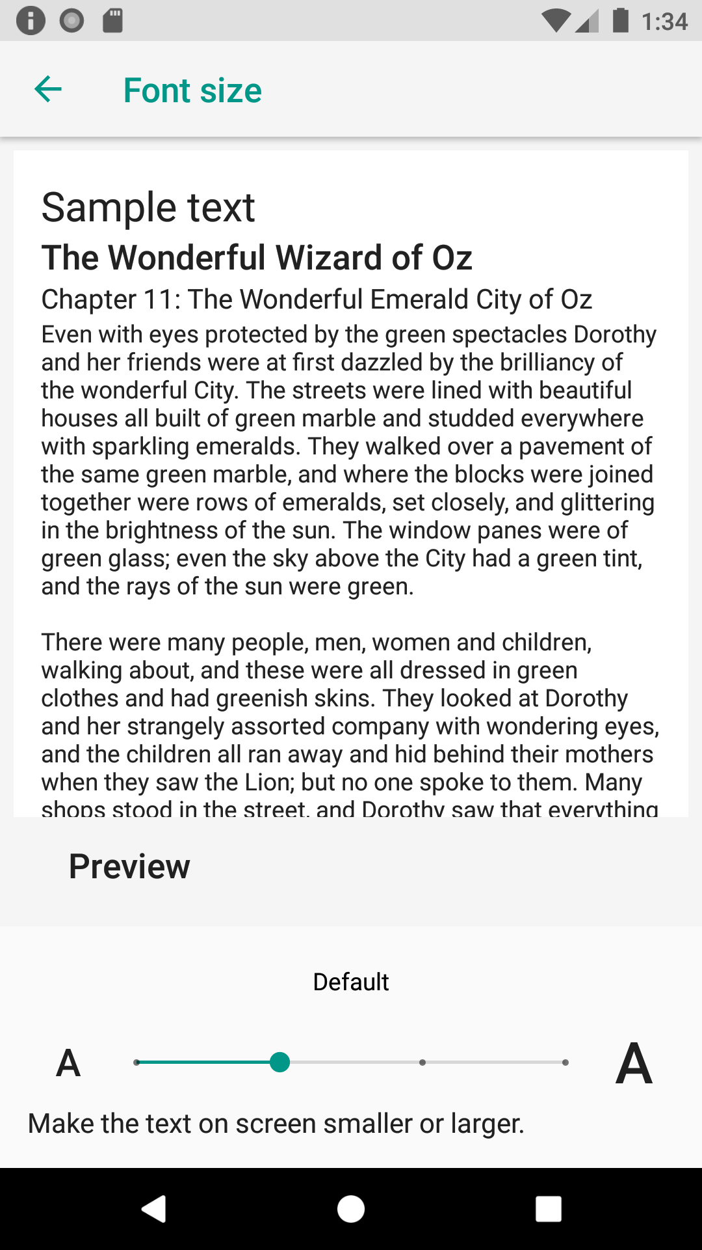
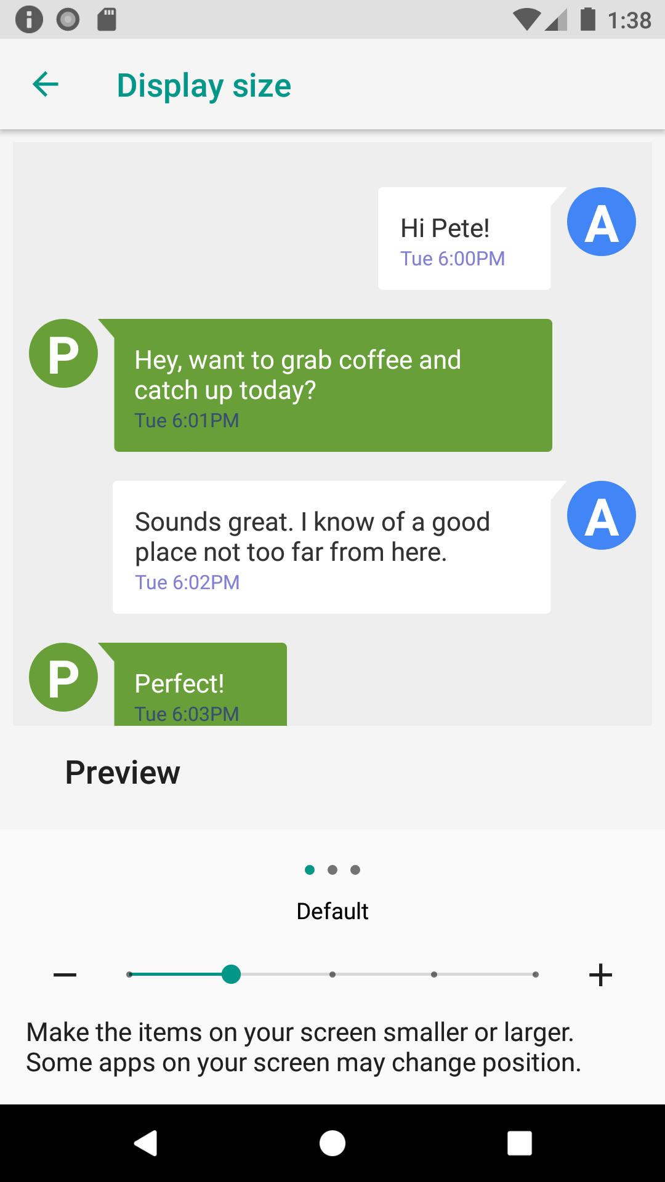
Scale-independent pixels (sp)
The textual equivalent to density-independent pixels (dp)
Specify text sizes in sp (takes into account user preferences)
Users can adjust Font and Display sizes in the Settings app (after Display)
Notes:
Scale-independent pixels (sp) are the measurement unit you should use for anything text-related. While dp is only affected by screen density, sp is also affected by the font and display size selected by the user in their Settings app. sp takes these different factors into account to arrive at a final text size.
Resources:
Supporting different pixel densities
Dimension

Slide 21
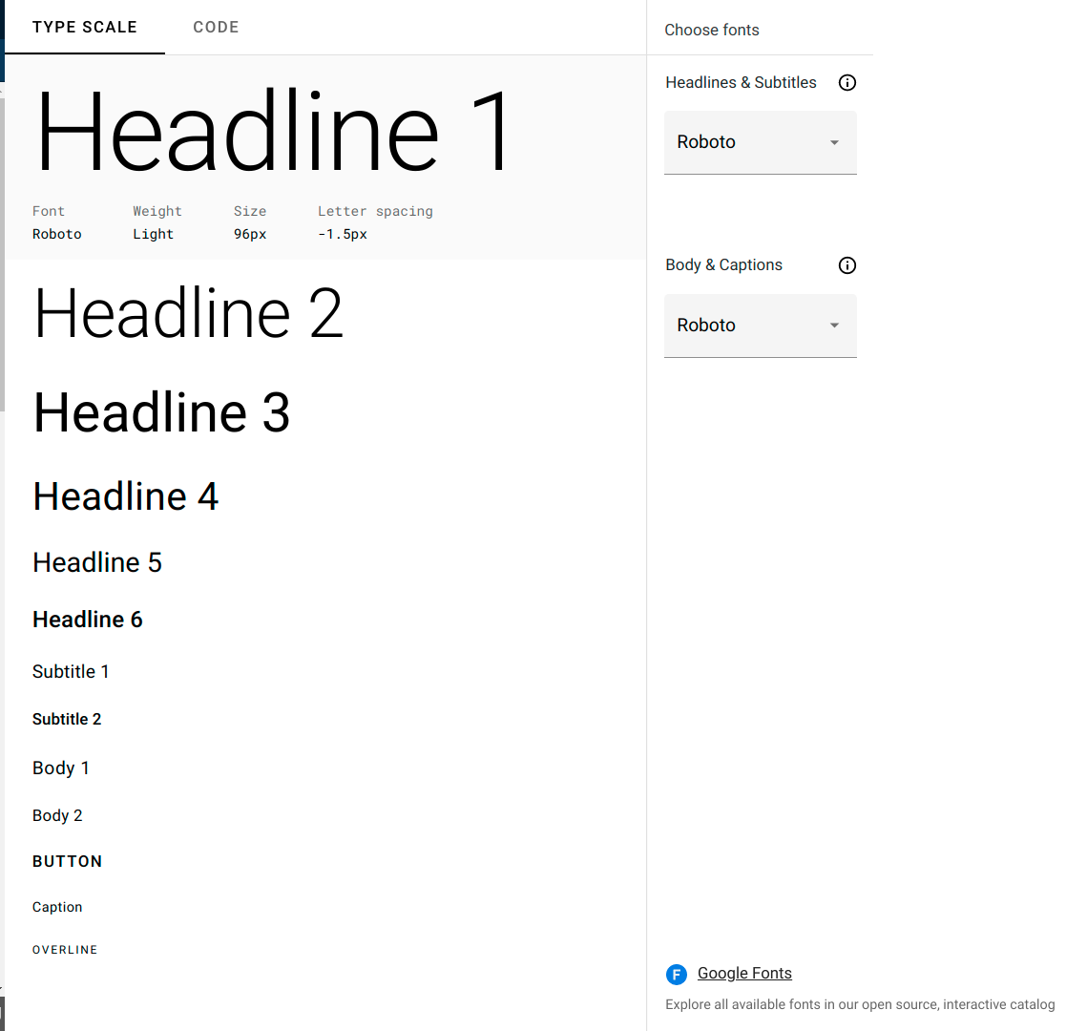
Type scale
A set of styles designed to work together in a cohesive manner for your app and content
Contains reusable categories of text with intended purpose for each (for example, headline, subtitle, caption)
Notes:
Resource:
Type scale

Slide 22
TextAppearance
A TextAppearance style often alters one or more of these attributes:
typeface (android:fontFamily)
weight (android:textStyle)
text size (android:textSize)
capitalization (android:textAllCaps)
letter spacing (android:letterSpacing)
Notes:
A predefined style within the type scale can be accessed as a TextAppearance.

Slide 23
Examples using TextAppearance
<TextView
...
android:textAppearance="@style/TextAppearance.MaterialComponents.Headline1"
android:text="@string/title" />
<TextView
...
android:textAppearance="@style/TextAppearance.MaterialComponents.Body1"
android:text="@string/body_text" />
Notes:
These examples show how to set a TextAppearance on a TextView, instead of setting the individual text attributes on the TextViews.
Resource:
Type scale

Slide 24
Customize your own TextAppearance
<style name="TextAppearance.MyApp.Headline1"
parent="TextAppearance.MaterialComponents.Headline1">
...
<item name="android:textStyle">normal</item>
<item name="android:textAllCaps">false</item>
<item name="android:textSize">64sp</item>
<item name="android:letterSpacing">0</item>
...
</style>
Notes:
You can even inherit from an existing text appearance style and modify it according to your use case. For example, you could customize the text appearance Headline1 and provide alternative values for textStyle, textSize, and so forth. Then you could use this style directly in your layout.

Slide 25
Use a custom TextAppearance in a theme
<style name="Theme.MyApp" parent="Theme.MaterialComponents.Light">
...
<item name="textAppearanceHeadline1">@style/TextAppearance.MyApp.Headline1</item>
...
</style>
Notes:
Or you could use the this new style in a theme. For example, within Theme.MyApp, you could provide your own Headline1 text appearance style for the textAppearanceHeadline1 theme attribute. Every time this theme attribute is requested, the value will be your custom text appearance.
Within a theme, all of the text appearance theme attributes can be overridden with your own values. See the list of possible attributes in the link below.
Resource:
Typography Theming

Slide 26
Material Design
Notes:
Now that we’ve covered core concepts in UI development on Android, let’s talk how we can use Material Design to create more beautiful and polished apps. Material is a design system created by Google to help people build high-quality experiences on mobile and web.

Slide 27
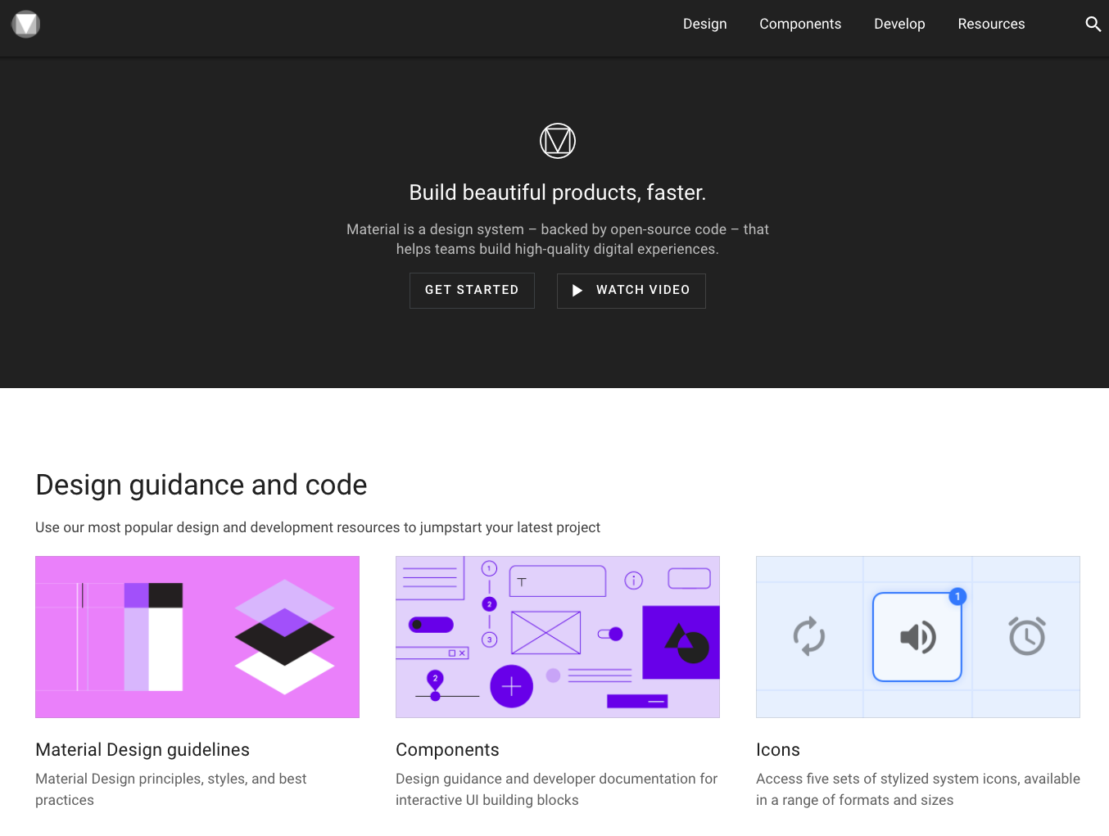
Intro to Material
Adaptable system of guidelines, components, and tools that support best practices for UI design
Material Design homepage
Notes:
We encourage you to check out the Material Design site for a wealth of information about Material Design guidelines, components, and implementation guidance.
The tools provided by Material Design let you make certain design decisions (e.g., about colors or typography styles), and have them reflected throughout your app UI, even down to how individual components look. This makes it easier to carry your design vision across the whole user experience and make it feel cohesive.
There’s an Android section of the site that talks about Material Design in the context of the Android platform. It is a great reference to keep coming back to as you build your apps and need to make design decisions.
Resources:
Material Design
Principles
Develop - Android

Slide 28
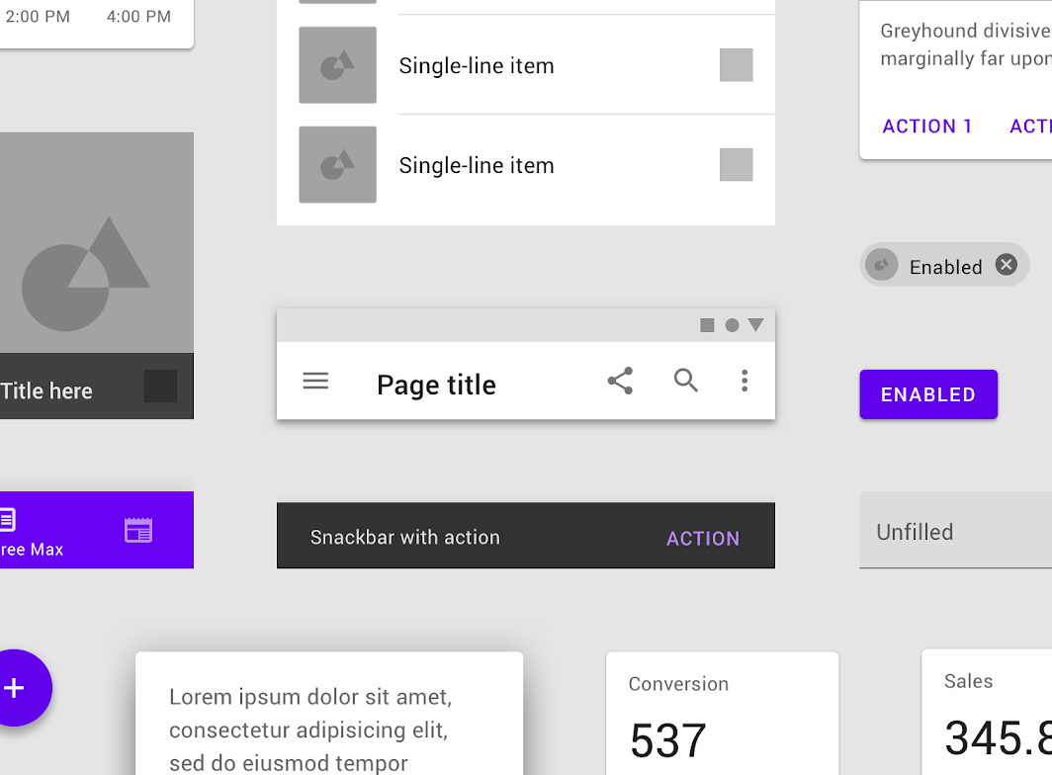
Material Components
Interactive building blocks for creating a user interface
Notes:
Material Components are interactive building blocks for creating a user interface, and come with a built-in way to communicate focus, selection, and other states. This makes it easier for developers to create beautiful and responsive UIs without having to worry about implementing those details themselves (like pressed states when you tap on a button).
We highly recommend that you use Material Components when building your app, so that you don’t have to reinvent the wheel.
Resources:
Material Android GitHub repo - where the latest Material Components are being developed

Slide 29
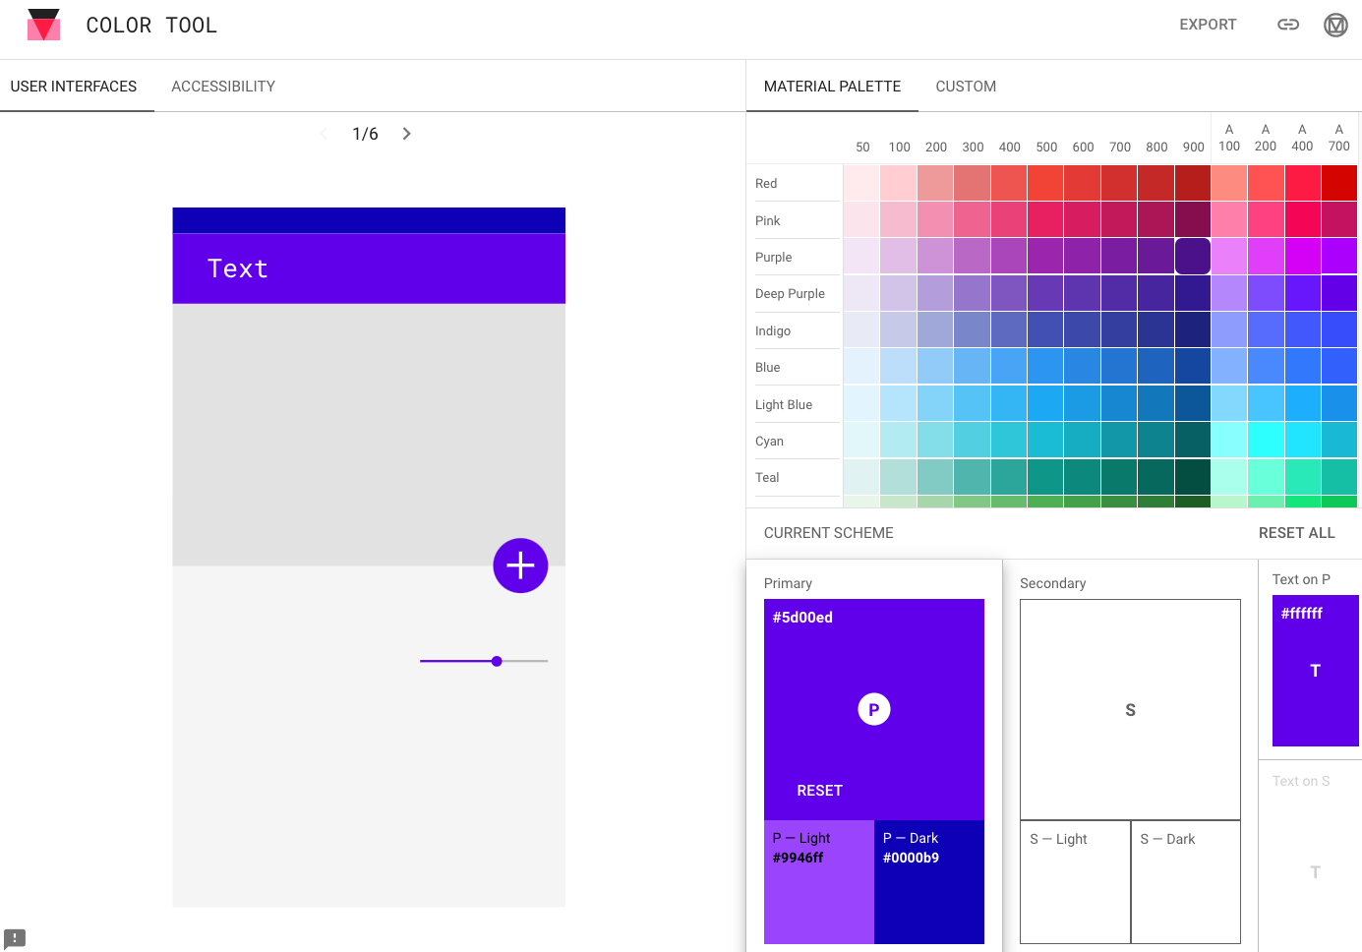
Material color tool
Notes:
Use this color tool to help you pick colors for your app theme. Choose from among the suggested colors in the Material Palette (on the right). It helps understand the accessibility of the color choices with large and normal sized text.
Resources:
Tools for picking colors
Color Tool

Slide 30
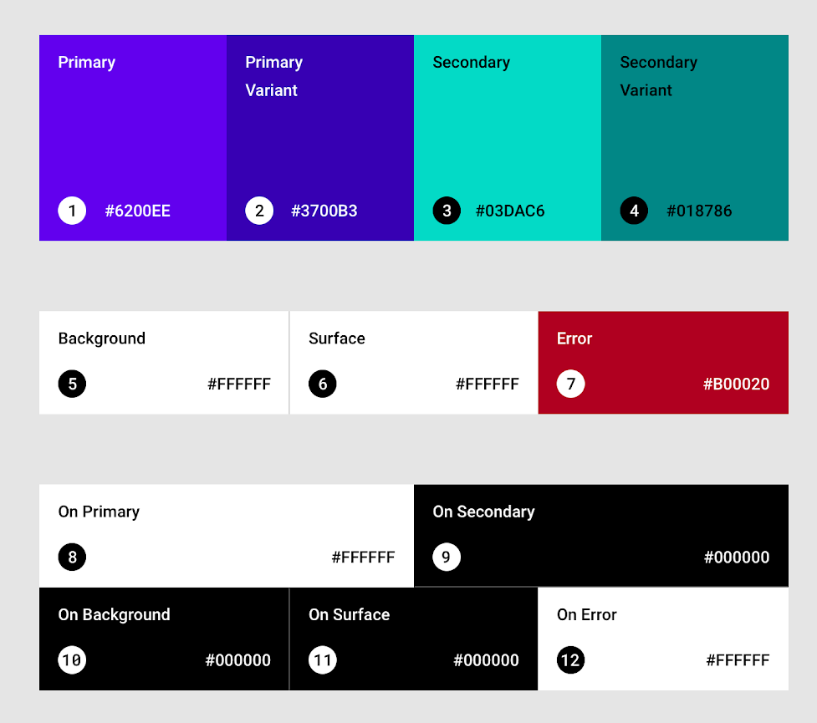
Baseline Material color theme
Notes:
If you don’t have a particular vision in mind, Material Design comes with a built-in baseline theme that can be used as-is, “out of the box.” You can customize it as much as you want.
The baseline theme includes default colors for primary and secondary colors (and their variants), background, surface, error, typography, and icon colors, as shown above.
Resource:
Color usage and palettes
Color theming

Slide 31
Material Components for Android Library
implementation 'com.google.android.material:material:<version>'
Notes:
We’ve mentioned that there are pre-built components and themes that you can take advantage of. This is all part of the Material Components for Android library. Make sure you include this dependency in your project. This is included in most projects by default, for example if you create a new project from a template in Android Studio.
To find out the latest version of the library, check out the Getting Started guide linked below.
Resource:
Getting Started

Slide 32
Material Themes
Theme.MaterialComponents
Theme.MaterialComponents.NoActionBar
Theme.MaterialComponents.Light
Theme.MaterialComponents.Light.NoActionBar
Theme.MaterialComponents.Light.DarkActionBar
Theme.MaterialComponents.DayNight
Theme.MaterialComponents.DayNight.NoActionBar
Theme.MaterialComponents.DayNight.DarkActionBar
Notes:
These are the themes that come with the Material Components library. Inherit from one of these themes, so that you get the latest component styles and theme attributes.
Resource:
Setting up a Material Components theme for Android

Slide 33
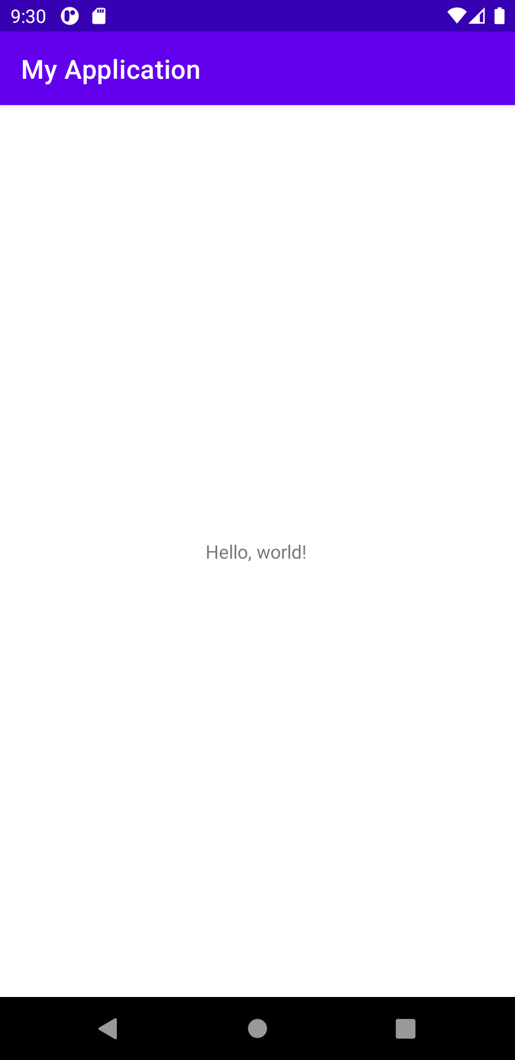
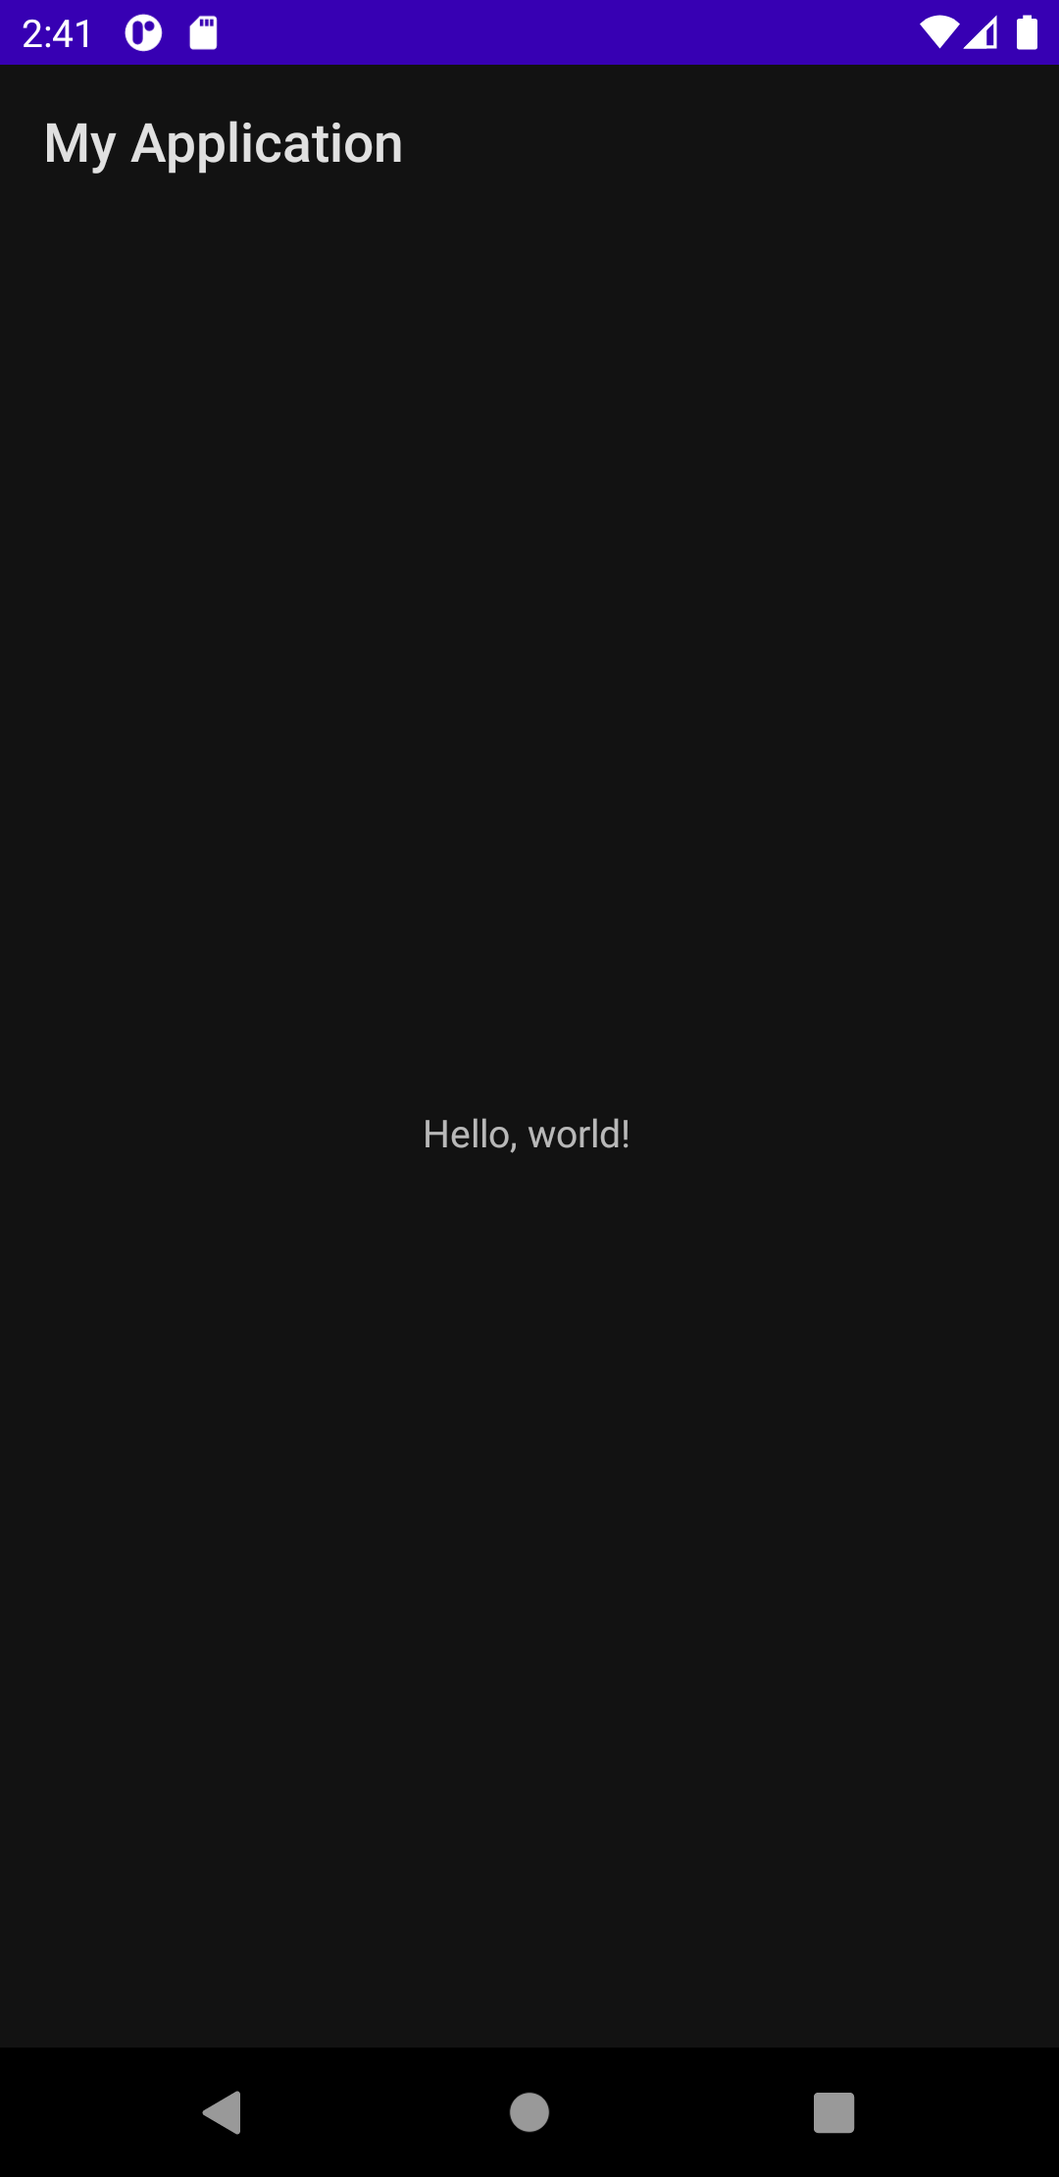
Material theme example
Theme.MaterialComponents.DayNight.DarkActionBar
Light mode
Dark mode
Notes:
Here’s an example of inheriting from the Theme.MaterialComponents.DayNight.DarkActionBar as the app theme. Choosing a DayNight theme gives the app a default Dark theme (when night mode is enabled on the device - see screenshot on the right).
The theme name also includes DarkActionBar, which means the app bar at the top of the screen is a dark color (purple). If the app bar was a lighter color (like yellow), then you would use Theme.MaterialComponents.DayNight instead. Choosing the right option will make sure the default color of the text and icons in the app bar will have sufficient color contrast with the color behind it.

Slide 34
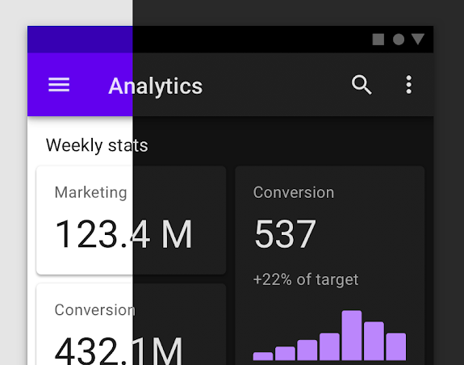
Dark theme
A low-light UI that displays mostly dark surfaces
Replaces light-tinted surfaces and dark text with dark-tinted surfaces and light text
Makes it easier for anyone to use a device in lower-light environments
Improves visibility for users with low vision and those sensitive to bright light
Can significantly reduce power usage (depending on the device)
Notes:
In Android 10 and above, a dark theme is provided in the platform. Dark theme is a low-light UI that displays mostly dark surfaces. It works by replacing light-tinted surfaces and dark text, with dark tinted surfaces and light text. Some of the benefits of the dark theme are shown above. You can enable night mode on a device from the Settings app (under Display > Dark theme).
Dark theme applies to the Android system UI, as well as apps running on the device. Here’s a screenshot of what an app screen would look like in the light mode versus dark mode. There are significantly less bright surfaces in the dark theme version, which makes it easier for users in lower-light settings.
Resources:
Dark theme
Dark theme - Material Design

Slide 35
Support dark theme
In values/themes.xml:
<style name="AppTheme" parent="Theme.MaterialComponents.DayNight">
<item name="colorPrimary">@color/orange_500</item>
...
In values-night/themes.xml:
<style name="AppTheme" parent="Theme.MaterialComponents.DayNight">
<item name="colorPrimary">@color/orange_200</item>
...
Notes:
This is what the themes.xml file will look like when you inherit from a DayNight theme to support dark theme in your app.
If you want to define a different theme for night mode, create a new themes.xml file in the values-night folder and specify the desired attributes. The themes in this file will be used when night mode is enabled on a device. In this example, we’ve set a different primary color (a lighter orange) for the app because desaturated colors are recommended for dark themes.

Slide 36
Material Components
Notes:
There are a number of widgets in the Material Components library to help you implement your UI more quickly. In this section, we’re going to highlight a couple that are common to many apps.

Slide 37
Material Components
Component library provided for Android and design guidelines
Text fields | App bars (top and bottom)
Buttons | Floating Action Button (FAB)
Menus | Navigation Drawer
Cards | Bottom navigation
Chips | Snackbar
...and more!
Notes:
Here are some examples of Material Components.
We encourage you to look at the full set of components at Components.
Example of Material guidelines on how to use Buttons: Buttons

Slide 38
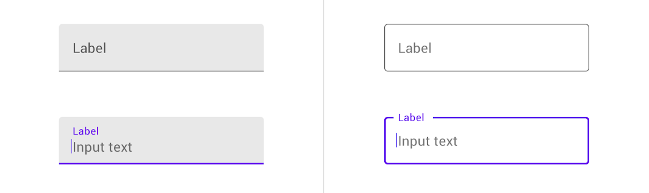
Text field
Composed of TextInputLayout with child view TextInputEditText
Shows a floating label or a text hint before the user enters text
Two types:
Filled text field
Outlined text field
Notes:
Instead of using an EditText, we recommend using Material text fields for where users enter and edit text. A Material text field is composed of a TextInputLayout and a TextInputEditText as a child view. These component APIs handle the heavy lifting for you to provide a text field that follows the Material guidelines for text fields on Android. For example, you can add a leading icon to a text field.
There are two types of text fields as shown in the diagram. If no style is set, then the filled text field is the default style. Filled text fields have more visual emphasis and stand out more compared to the outlined text field.
Resource:
Text fields

Slide 39
Text field example
<com.google.android.material.textfield.TextInputLayout
android:id="@+id/textField"
android:layout_width="match_parent"
android:layout_height="wrap_content"
android:hint="@string/label"
style="@style/Widget.MaterialComponents.TextInputLayout.OutlinedBox">
<com.google.android.material.textfield.TextInputEditText
android:layout_width="match_parent"
android:layout_height="wrap_content" />
</com.google.android.material.textfield.TextInputLayout>
Notes:
Here’s an example of declaring a text field in your layout XML. The hint for the text field is set on the TextInputLayout. We also set the style to be an outlined text field by using @style/Widget.MaterialComponents.TextInputLayout.OutlinedBox.
Resource:
Text fields

Slide 40
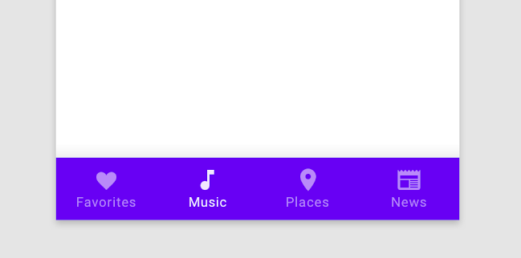
Bottom navigation
Allows movement between top level destinations in your app
Alternate design pattern to a navigation drawer
Limited to 5 locations max
Notes:
Another useful component is a Bottom Navigation bar. It lets users navigate between different top-level destinations in your app - sibling screens that are not hierarchically related to each other and may each have their own set of related destinations. Like the navigation drawer and app bar, you specify your locations using a menu resource file.
Resource:
Bottom navigation

Slide 41
Bottom navigation example
<LinearLayout …>
...
<com.google.android.material.bottomnavigation.BottomNavigationView
android:id="@+id/bottom_navigation"
android:layout_width="match_parent"
android:layout_height="wrap_content"
app:menu="@menu/bottom_navigation_menu" />
</LinearLayout>
Notes:
First declare the menu destinations in a menu resource file (e.g., res/menu/bottom_navigation_menu.xml). Then modify your layout to include a BottomNavigationView (which points to the menu resource) as shown above.
Resources:
Bottom navigation
BottomNavigationView

Slide 42
Bottom navigation listener
bottomNav.setOnNavigationItemSelectedListener { item ->
when(item.itemId) {
R.id.item1 -> {
// Respond to navigation item 1 click
true
}
R.id.item2 -> {
true
}
else -> false
}
}
Notes:
Then within the activity or fragment code (depending on which layout it was declared in), get a reference to the BottomNavigationView (bottomNav in this case). Next define and set an OnNavigationItemSelectedListener to the BottomNavigationView to handle when each navigation item is selected.
Resource:
NavigationView.OnNavigationItemSelectedListener

Slide 43
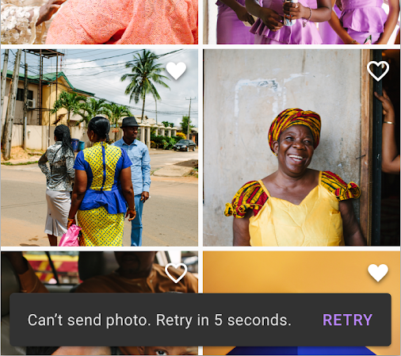
Snackbar
Display short messages within the app
Messages have a duration (SHORT, LONG, or INDEFINITE)
May contain an optional action
Works best in a CoordinatorLayout
Shown at bottom of enclosing container
Notes:
In addition to providing short messages about what’s going on in an app (for example, if some items have been deleted or archived), Snackbars give the user the ability to execute an action. This can be simply dismissing the notification, confirming a selection, or undoing the last action.
Resource:
Snackbars

Slide 44
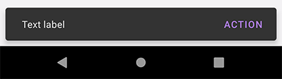
Snackbar examples
Show a simple message:
Snackbar.make(view, R.string.text_label, Snackbar.LENGTH_SHORT)
.show()
Add an action to a Snackbar:
Snackbar.make(view, R.string.text_label, Snackbar.LENGTH_LONG)
.setAction(R.string.action_text) {
// Responds to click on the action
}
.show()
Notes:
Transition: 1 click
To create a Snackbar, you use its static make function and supply a View, a string or a resource ID for the text to display, and a duration for how long to display the message.
Note that calling make() creates the Snackbar instance, but doesn't make it visible on screen until you call the show() method on it.
Resource:
Snackbar

Slide 45
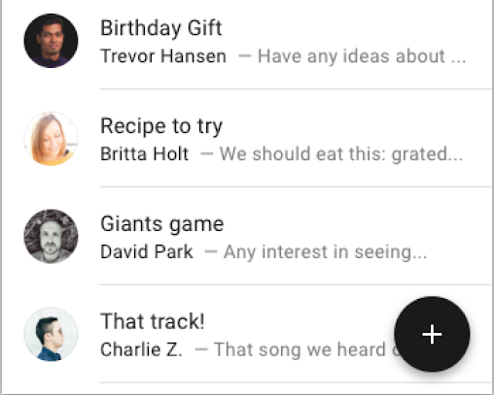
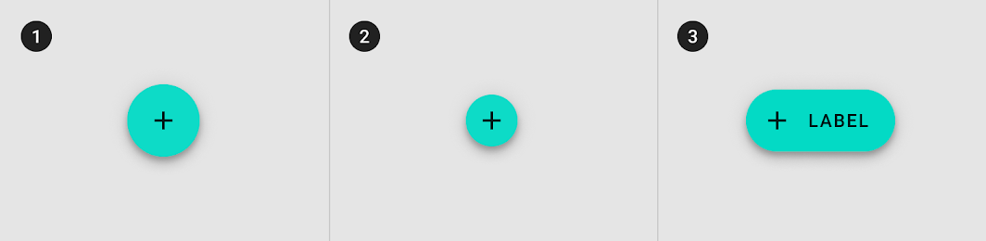
Floating Action Button (FAB)
Perform the most-common action for a screen (for example, creating a new email)
Come in multiple sizes (regular, mini, and extended)
Notes:
Another common UI element you’ll see in apps is a floating action button (as known as FAB), which represents the primary action of the screen.
There are 3 types of FABs. For most cases, use a regular FAB (1) with an enclosed icon. Mini FABs (2) are for cases where the device’s screen is small, or a smaller FAB is needed to maintain continuity with other app elements. Extended FABs (3) include text and an optional icon.
Resources:
Buttons: floating action button
Floating action buttons on Android

Slide 46
CoordinatorLayout
Acts as top-level container in an app
Manages interaction of its child views, such as gestures
Recommended for use with views like a Snackbar or FAB
Notes:
When using a Snackbar or FAB in your layout, it’s recommended to add them as a child of a CoordinatorLayout.
You can think of a CoordinatorLayout as a super-powered FrameLayout. CoordinatorLayout can be used as a container for a specific interaction with one or more child views.
Snackbar works best within a CoordinatorLayout for behavior like being able to swipe-to-dismiss the Snackbar.
When using a FAB within CoordinatorLayout, certain cases are handled automatically (e.g., FAB moving over if a Snackbar appears).
Resource:
CoordinatorLayout

Slide 47
FAB example
<androidx.coordinatorlayout.widget.CoordinatorLayout ...>
....
<com.google.android.material.floatingactionbutton.FloatingActionButton
android:id="@+id/floating_action_button"
android:layout_width="wrap_content"
android:layout_height="wrap_content"
android:layout_gravity="bottom|end"
android:layout_margin="16dp"
android:contentDescription="@string/fab_content_desc"
app:fabSize="normal" <!-- or mini or auto -->
app:srcCompat="@drawable/ic_plus"/>
</androidx.coordinatorlayout.widget.CoordinatorLayout>
Notes:
Here’s an example where we add a FloatingActionButton within a CoordinatorLayout. Most of the attributes in the Android namespace are ones we’ve used before.
Two that need highlighting are layout_gravity and contentDescription. layout_gravity specifies how a view will place itself in its container’s layout. In this case, it positions the FAB to the bottom and end of the containing CoordinatorLayout (with a margin) The other relevant attribute is contentDescription, which helps screen readers know the purpose of the FAB even when there is no text on the FAB.
fabSize can be normal (56dp), mini (40dp) or auto. Auto uses the window size to determine a reasonable button size.
Once the FAB is declared in your layout, you can set a click listener on the button, just as you have done before with other buttons.
Resources:
Add a Floating Action Button
FloatingActionButton
LinearLayout.LayoutParams

Slide 48
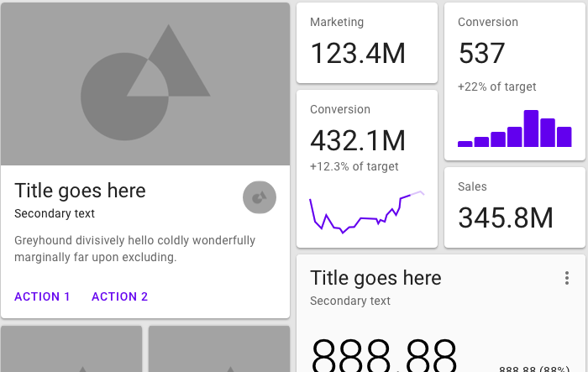
Cards
A card holds content and actions for a single item.
Cards are often arranged in a list, grid, or dashboard.
Use MaterialCardView.
Notes:
The last component we’ll talk about today is cards. You likely have seen apps that display information as a list of cards, where each card may represent a news article or social media post for example. Use MaterialCardView to implement cards in your app.
Resource:
Cards
Cards

Slide 49
MaterialCardView example
<com.google.android.material.card.MaterialCardView
android:layout_width="match_parent"
android:layout_height="wrap_content"
android:layout_margin="8dp">
</com.google.android.material.card.MaterialCardView>
<LinearLayout
android:layout_width="match_parent"
android:layout_height="wrap_content"
android:orientation="vertical">
<ImageView .../>
<TextView .../>
</LinearLayout>
Notes:
Transition: 1 click
MaterialCardView extends from FrameLayout, which can only display a single child View. You will likely need to set the child of MaterialViewGroup to be a ViewGroup, like ConstraintLayout or LinearLayout, which can in turn have child views for the contents of the card and position them accordingly.
The child LinearLayout holds the main contents of the card.
Resource:
com.google.android.material.card.MaterialCardView

Slide 50
Localization
Notes:
Building for Android means you could have a global audience. Some resources in your app may only make sense to a specific culture. Therefore, you may want the ability to provide alternative resources depending on the language and culture of the user.

Slide 51
Localize your app
Separate the localized aspects of your app (for example, text, audio files, currency, and numbers) as much as possible from the core Kotlin functionality of the app.
Example: Extract the user facing strings into strings.xml.
When a user runs your app, the Android system selects which resources to load based on the device's locale.
If locale-specific resources are not found, Android falls back to default resources you defined.
Notes:
It's a good practice to keep language and culture-specific resources separated from the rest of your app. Within your Android project, add support in your app for different locales by providing alternative resources in directories with the appropriate resource qualifiers.
Resources:
Localize your app
Locale

Slide 52
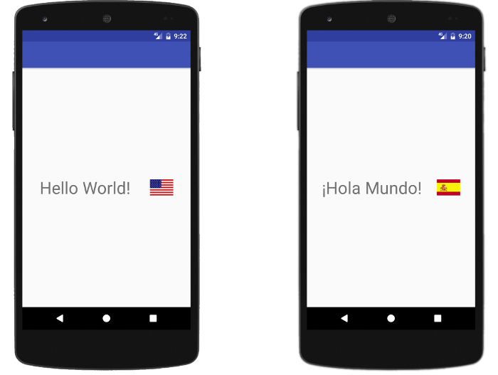
Support different languages and cultures
Decide which locales to support.
Create locale-specific directories in res directory:
<resource type>-b+<language code> [+<country code>]
Examples: layout-b+en+US values-b+es
Provide locale-specific resources (such as strings and drawables) in those directories.
Notes:
Once you have specified default resources for your app, you can provide alternative resources for other locales. Name the locale-specific directories according to the format <resource type>-b+<language code>[+<country code>].
Examples:
layout-b+en+US for locales with English language code and US country code
values-b+es for locales with Spanish language code
In this graphic, the app uses different string and drawable resources in the default en_US locale compared to the es_ES locale.
Resources:
Use the resources in your app
Localize your app
Supporting different languages and cultures

Slide 53
Support languages that use RTL scripts
Users can choose a language that uses right-to-left (RTL) scripts.
Add android:supportsRtl="true" to app tag in manifest.
Convert left and right to start and end, respectively, in your layout files (change android:paddingLeft to android:paddingStart).
Localize strings and format text in messages.
Optionally, use -ldrtl resource qualifier to provide alternate resources.
Notes:
To add support to your app for languages that use right-to-left (RTL) scripts, such as Arabic or Hebrew, make the following changes. First specify android:supportsRtl="true" on the application tag in the AndroidManifest.xml file. Be sure that your app’s target SDK version is at least 17 or higher.
People who use RTL scripts prefer an RTL user interface, which includes right-aligned menus, right-aligned text, and forward arrows pointing to the left. If you haven’t already, convert left and right to start and end, respectively, in each of your existing layout resource files. By doing this, you allow the framework to align your app's UI elements based on the user's language settings.
Also localize strings and format text in messages so that they appear correctly. You can also provide specific resources using the -ldrtl (layout-direction-right-to-left) and -ldltr (layout-direction-left-to-right) resource directory qualifiers.
Resource:
Support layout mirroring
Format text in messages

Slide 54
Example apps
Notes:
There was a lot of information covered in this lesson and this whole course! Sometimes it’s helpful to see all the concepts and best practices interweaved together in end-to-end examples.

Slide 55
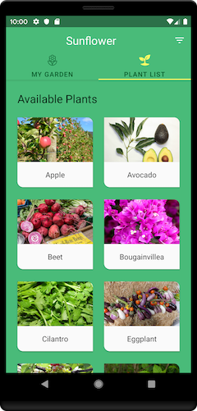
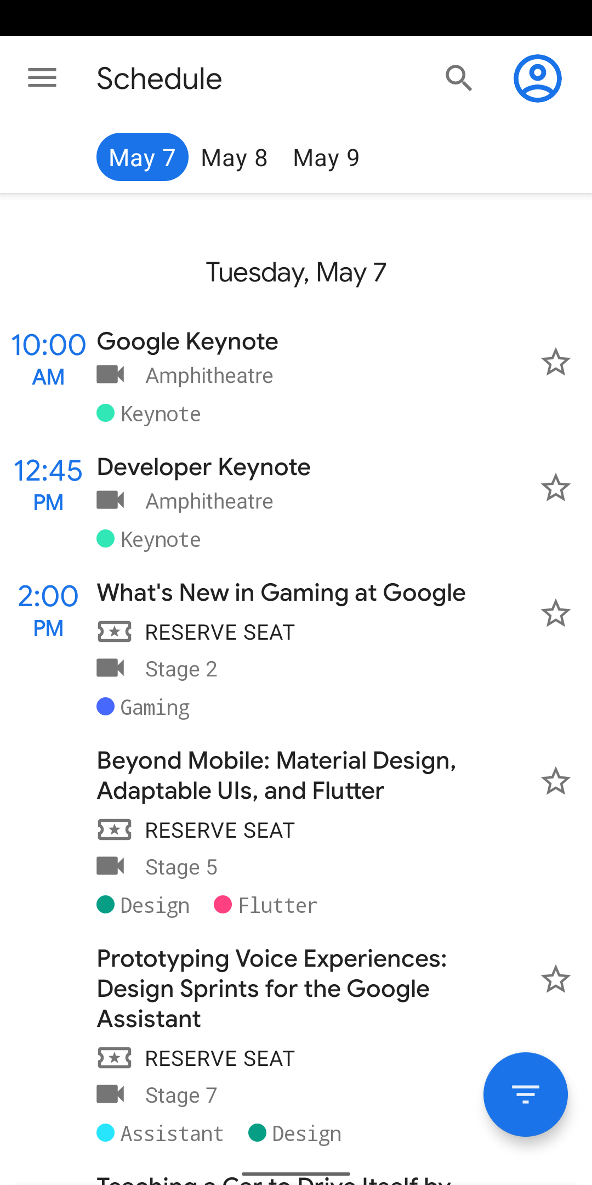
Check out other apps
Sunflower app
Google I/O app
Notes:
Here are a couple of open-source apps created by the Android team to help showcase best practices.The Android GitHub account has more sample code. Or you can search online for more open-source Android apps that were created by the developer community.
You can also check out Material Studies for more examples of Material theming and components.
Resources:
Sunflower app
Google I/O Android App

Slide 56
Summary

Slide 57
Summary
In Lesson 13, you learned how to:
Customize the visual look of your app using styles and themes
Choose from predefined type scales for the text in your app (or create your own text appearance)
Select theme colors for your app using Material color tool
Use Material Components library to speed up UI development
Localize your app to support different languages and cultures

Slide 58
Learn more
Material Design
Material Components
Tools for picking colors
Dark theme
Localize your app
Blog posts: Themes vs Styles, Common Theme Attributes, Prefer Theme Attributes, Themes Overlay
Sample code: Sunflower app, Google I/O app, Android GitHub repo

Slide 59

Pathway
Practice what you’ve learned by completing the pathway:
Lesson 13: App UI Design

